Slide 1

Capstone Project Phase-1
Project Title: Using Digital Twinning to enhance Human-Robot Collaboration with augmented reality
Project ID: PW23_AKP_02
Project Guide: Dr.Ashok Kumar Patil
Project Team: 2_7_158_237

Slide 2
Outline
Abstract
Suggestions from Review 1
Constraints/ Dependencies / Assumptions / Risks
Functional Requirements
Non- Functional Requirements
Literature Survey
Summary of Literature Survey
Any other information
Conclusion
References

Slide 3
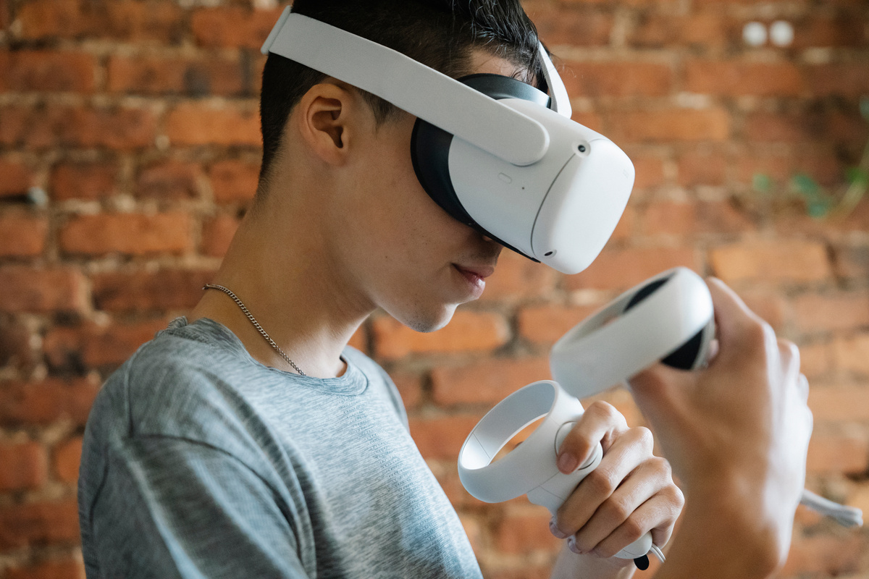
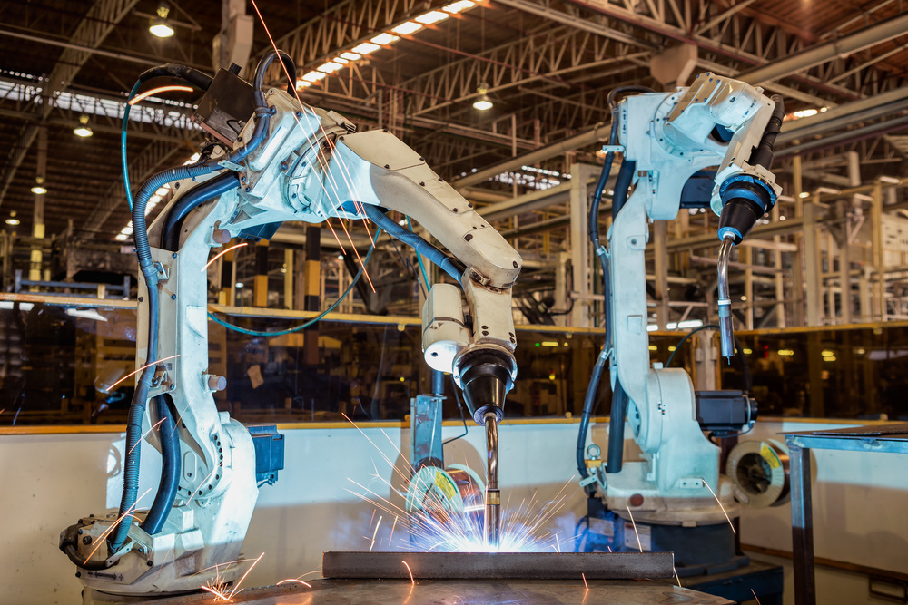
Abstract
Developing an AR/VR tool which can be used to enhance industrial robotics.
A digital twin of the robot is made and simulated to run on an AR/VR interface.
Scope:
Real-time monitoring and control of robotic systems
Predictive Remote maintenance, optimization and programming of operations
Virtual prototyping and training of robotic systems

Slide 4
Suggestions from Review 1

Slide 5
Constraints/ Dependencies/ Assumptions/ Risk
Dependency-
Resolution of movement
Encoder accuracy
Accuracy of model
Assumptions-
<FILL>
Risk-
Data transfer failure
Network failure
Robot failure

Slide 6
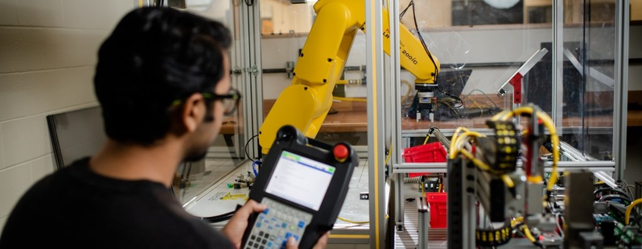
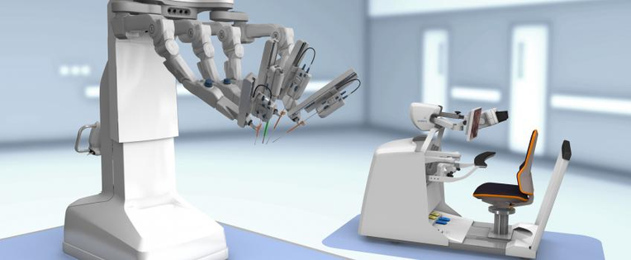
Functional Requirements
System should be able to accept data from a robot and reproduce movements on the digital twin.
System should be able to control the robot through the digital twin.
System should be accessible at all times over the internet.

Slide 7
Non – functional requirements
System should be secure and protected since its on the internet.
System should be quick and responsive.

Slide 8
Literature Survey
Digital Twin Data Modeling with AutomationML and a Communication Methodology for Data Exchange. (Communication)
Paper proposes use of AutomationML for data modeling and communication methodologies for data exchange which can facilitate the creation and management of digital twin systems. Further research is needed to explore the effectiveness of these approaches in real-world applications and to address potential challenges such as scalability and interoperability.
The Digital Twin: Realizing the Cyber-Physical Production System for Industry 4.0. (Digitalizing)
The article discusses the importance of digital twins in Industry 4.0, where cyber-physical systems and the Internet of Things are increasingly prevalent. Digital twins can be used to simulate and test physical systems before they are built, allowing for more efficient and cost-effective development processes. They can also be used to monitor and optimize the performance of existing systems in real-time.
Digital twin driven human–robot collaborative assembly. (Framework)
The paper discusses the use of digital twins in improving human-robot collaborative assembly processes. The authors propose a framework for using digital twins to simulate and optimize the assembly process, as well as to facilitate communication between human workers and robots.
The framework includes several components, including a digital twin of the assembly environment, a digital twin of the product being assembled, and a digital twin of the robot being used in the assembly process.
Digital Twin based synchronized control and simulation of the industrial robotic cell using Virtual Reality. (Digitalizing)
The paper proposes a technique that involves the creation of a virtual replica of a physical manufacturing environment, which can be used to simulate and optimize the performance of industrial robots in real-time. This technology involves the use of sensors, internet of things (IoT) devices, and other connected technologies to monitor and collect data on the physical environment.

Slide 9
Any other information
Tools and processes:
3D modeling - blender, Unity3D
AR platform - Industrial AR tools
Robotics- Raspberry pi, ArduinoIDE, ROS
Languages- C++, C#, python.
Research done -
https://docs.google.com/spreadsheets/d/1Uet7KWej06JfQ50rUx7eLIetOz4LF18dSRvonRCbmfc/edit#gid=0

Slide 10
Conclusion

Slide 11
References

Slide 12
Thank You

